Slide 1
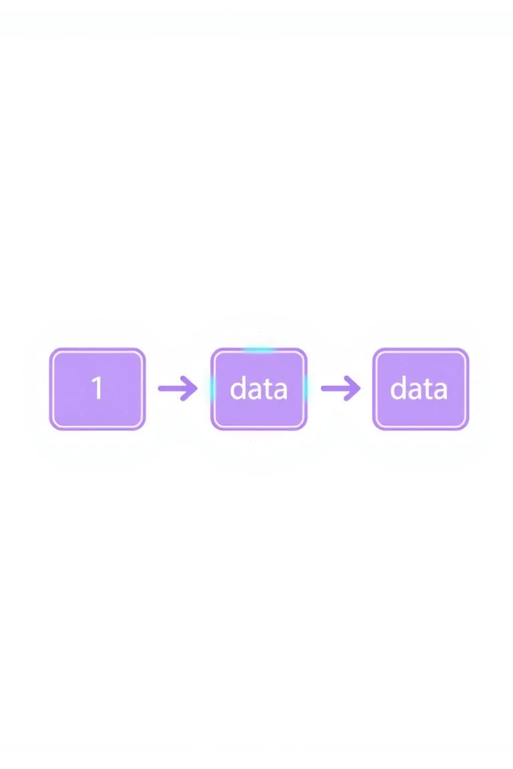
What is Blockchain?
This technology is a distributed digital ledger. It links blocks of transactions with hashes. Operates on a secure, peer-to-peer network without central control.

Slide 2
The History of Blockchain
1
1991: Cryptographic Time-stamping
2
2008: Bitcoin Whitepaper
Haber and Stornetta introduce secure timestamping for documents.
Satoshi Nakamoto presents blockchain as a solution for digital currency.
3
2009: Bitcoin Genesis Block
4
2015: Ethereum & Smart Contracts
The first block of the Bitcoin blockchain is mined, starting the network.
Introduction of programmable contracts expands blockchain capabilities.

Slide 3
Inside a Block
Block Components
Chain Security
Transactions recorded
Hashes link blocks
Timestamp marks creation
Immutable chain structure
Unique hash identifier
Tampering invalidates chain

Slide 4
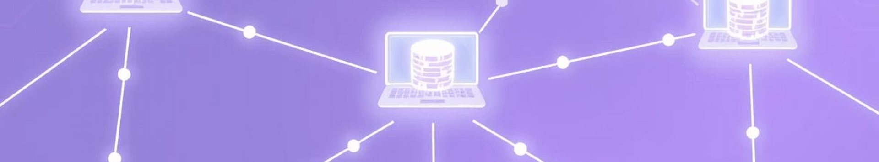
Decentralization & Agreement
Ledger Copies
Consensus Mechanisms
Proof of Work vs Proof of Stake
Every node holds the full ledger copy.
Nodes agree through consensus for valid transactions.
PoW uses computing power, PoS relies on stake ownership.

Slide 5
What Are Smart Contracts?
Self-executing Programs
No Middleman Needed
Example: Escrow
Run automatically on the blockchain once conditions meet.
Automate agreements without intermediaries or delays.
Funds release automatically without a lawyer’s involvement.

Slide 6
Blockchain in Banking & DeFi
Cross-Border Payments
Decentralized Finance
Benefits
Services like Ripple and Stellar improve speed and cost.
Platforms such as Aave and Compound offer lending and borrowing.
Lower fees, faster transactions, no intermediaries required.

Slide 7
Transparency & Trust in Tracking
Food Traceability
Pharma Verification
Trust & Security
Walmart + IBM ensure safety and freshness in foods.
Drug authenticity and patient data tracking with tamper-proof records.
Blockchain provides an immutable audit trail across supply chains.

Slide 8
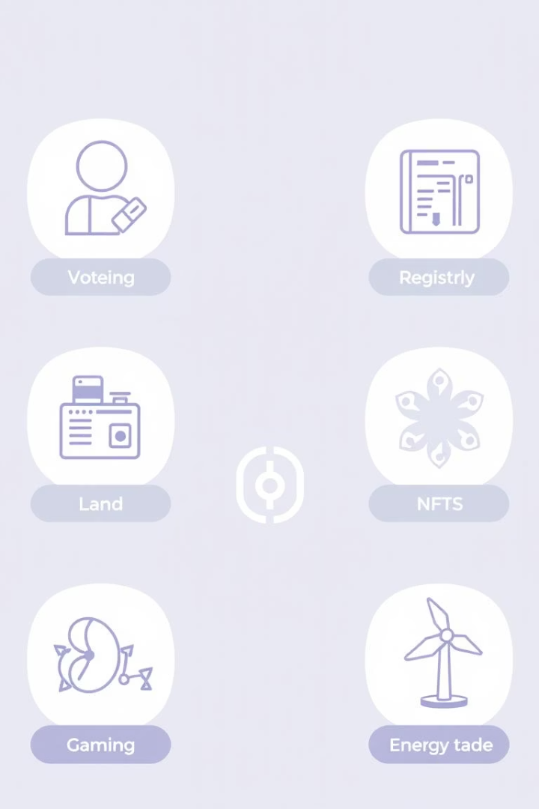
Blockchain Beyond Money
Digital Identity
Government Uses
Examples include Estonia’s e-Residency programs.
Secure voting systems and land registry management.
New Markets
NFTs, gaming assets, and blockchain energy trading platforms.

Slide 9
Solving Today’s Digital Problems
Trustless Systems
Decentralization
Market Growth
Ensures data integrity without trusted third parties.
Networks gain resilience and reduce single points of failure.
Rising enterprise adoption drives blockchain innovation worldwide.

Slide 10
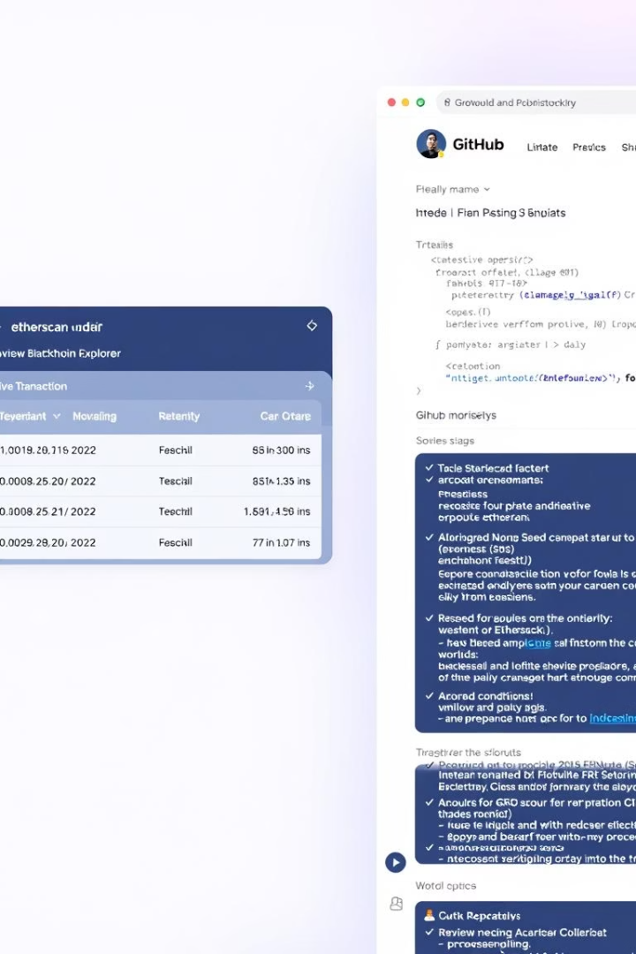



Let’s See It in Action!
Etherscan Demo
Deploy Smart Contract
Track real-time Ethereum transactions effortlessly.
Optional exercise with Remix IDE for hands-on learning.
Additional Resources
Visit blockchain.com, IBM Blockchain, and Hyperledger for deep dives.

